Slide 1
Welcome to Open House
3rd Grade

Slide 2
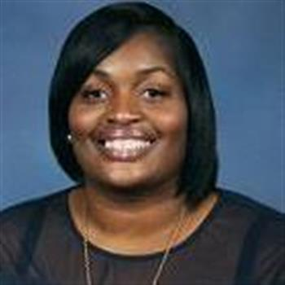
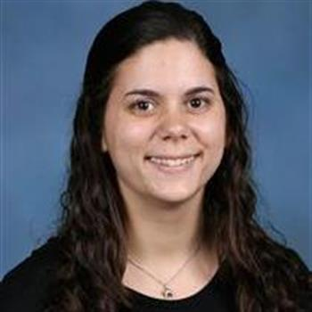
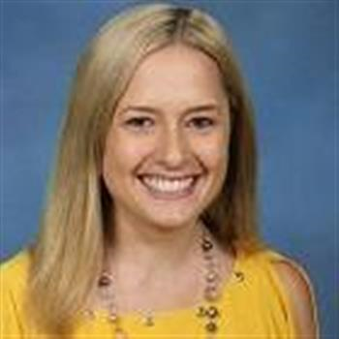
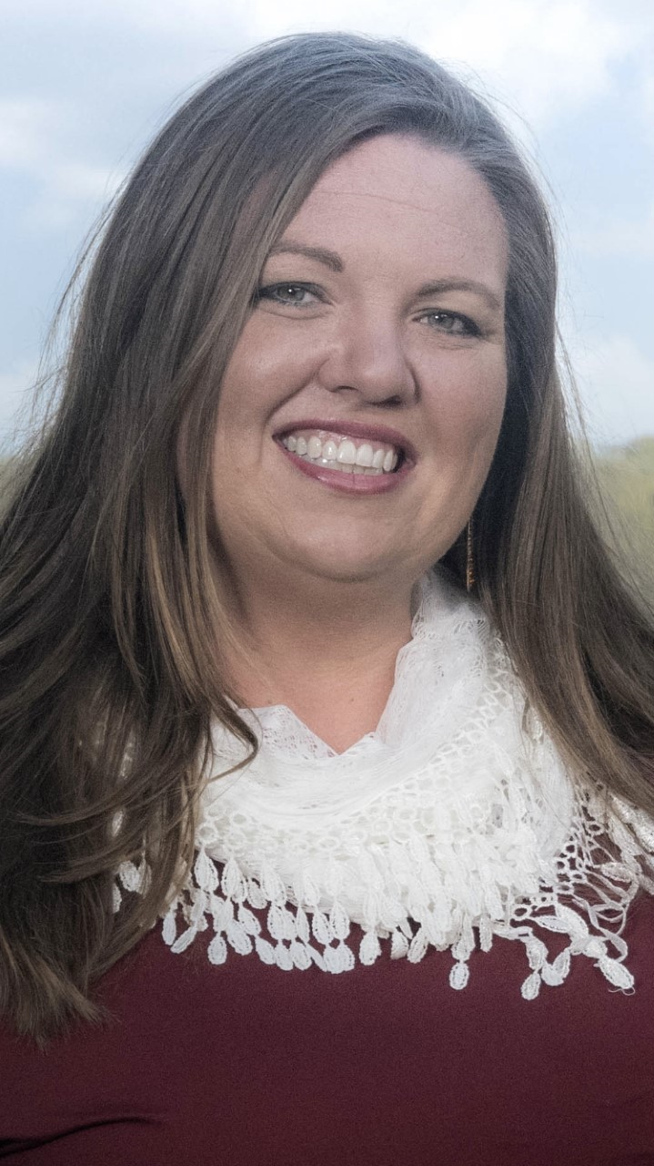
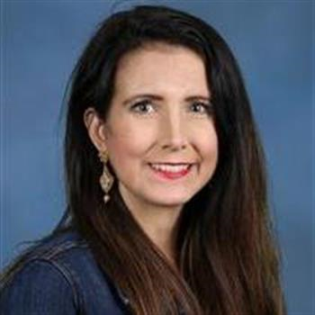
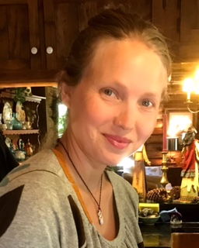
3rd Grade Teachers

Slide 3
Teachers Contact Info
*From left to right on previous slide*
Samantha Bouie-bouies@leonschools.net
Ginny Telander- telanderv@leonschools.net
Brianna Barrett- barrettb@leonschools.net
Carmen Cox- coxc@leonschools.net
Meghan Howell- howellm@leonschools.net
Tricia Francis- Francisp@leonschools.net
School Number: (850) 487-1216

Slide 4
Daily Schedule
8:45-9:15: Reading Interventions
9:15-10:30: Whole Group Reading
10:30-10:55: Whole Group Math
11:00-11:25: Lunch
11:30-11:50: Recess
11:55-1:00 Whole Group Math
1:05-1:50: Special Area
1:55-2:40: Science/Social Studies
2:40-2:50: Pack-up/ Dismissal
*Daily Schedules may differ a bit with every classroom. Please consult with your child’s teacher for their classroom schedule.

Slide 5
School & Class Rules and Expectations
Students will:
-Follow directions quickly
-Raise your hand for permission to speak or leave your seat
-make smart choices
- Be Respectful
-Be Responsible
-Be Safe

Slide 6
Consequences
Please check with your child’s teacher for their classroom consequences.

Slide 7
Positive Behavior System
-Earning Tickets to Class Store
Verbal Praise
Celebration Tickets
Positive Notes home
Lunch Bunch

Slide 8
Grading Policy
-Reading and Writing are under Language Arts.
--All students will receive grades A-F.
A-90%-100% D-60%-69%
B-80%-89% F-Below 69%
C-70%-79%

Slide 9
Grading Policy
Language Arts:
Weekly Wonders Assessments – 70%
Spelling and Vocabulary- 20%
Skill-base Assignment, Grammar Activities, Classwork – 10%
Math:
Chapter Assessments – 70%
Chapter Review – 20%
Mid. Chapter Checkpoint- 10%
Science:
Standards Assessment – 70%
Quizzes, Classwork, Activities/ Projects – 20%
Participation- 10%
Social Studies:
Standards Assessment – 70%
Quizzes, Classwork, Activities/Projects – 20%
Participation- 10%

Slide 10
Assessment Calendar
-Language Arts Assessments will be given on Day 7 and 8. These will include the comprehension and vocabulary skill. Please read the newsletter every Friday to see when tests will be.
-Spelling & Vocabulary will be on Day 7 and 8.
-Math, Science, and Social Studies will be after the review day of each chapter.

Slide 11
Accelerated Reader
-Used as a motivational tool to encourage students to read.
-Students take a test to give them a reading zone.
-This reading zone gave students a goal to meet in a 9-week period.
-Students must read and take A.R. tests with 80% comprehension to get the Works Independently check on the report card.

Slide 12
Accelerated Reader (cont.)
-Students will have time to read in class and at home.
-Students can take books home, but please make sure students return any books that are borrowed.
-Students who meet their A.R. goal will be rewarded at the end of every 9 weeks.
-Arbookfind.com

Slide 13
Homework
-All Language Arts homework will be sent home on Day 1 of Wonders. Math homework will be sent home daily and will need to be returned the following day. Students should be writing their homework in their agenda book. Students need to read for 20 minutes every night. Students need to record the book they read and how long they read for in their agenda book.

Slide 14
Take Home Folders
Completed assignments will go home in their “Take Home Folder”. Please take the assignments out and return the empty folder.

Slide 15
Water Bottles, Money, Medicine
Your child can bring in one water bottle to have at their desk. Please make sure it is just water.
When turning money in please place it in a sealed envelope and label it.
If your child takes any medicine at school it must be handled by the clinic. Please contact the nurse if you have any questions.

Slide 16
Parent-Teacher Communication
-Student Binder:
-Weekly Newsletter
-School Newsletter
-Monthly Behavior Report
-Student Work

Slide 17
Contact
To contact me you can email me, call the school, or message me on the app Remind. If you have not already signed up for Remind, please do so!

Slide 18
Attendance Policy
-If your child is sick or has an excused absent please send in a note.
-On the final report card, student’s attendance will be evaluated as acceptable or unacceptable.

Slide 19
Birthdays
*Due to COVID, classroom birthday celebrations look a little different.
Please ask your child’s teacher how birthdays will be celebrated in class before the child’s birthdate.
Thank You!

Slide 20
Online Gradebook- FOCUS
Please sign-up! There will be lots of communication through FOCUS this year. If you do not have sign-up credentials, please let you child’s teacher know.

Slide 21
Field Trips & Fun Events
More information will be provided about field trips/ fun events after the first 9-weeks.
Stay Tuned!

Slide 22
Volunteers Are Always Welcome!
-If you are available to volunteer your time to work on activities, rip & staple tasks, or taking groups of students to the Media Center to exchange books, please let me know! I will always have something ready if you let me know you’re coming!
-We truly appreciate your help!
- Sign up for the volunteer application online at leonschools.net

Slide 23
Parent-Teacher Conferences
Conferences will be held via ZOOM. Your child’s teacher will have a sign-up genius link sent to you on Remind.
Look out for this link in the upcoming weeks.

Slide 24
Questions or Concerns
-Many questions/concerns will be addressed during your parent/teacher conference.
If there are questions/concerns that need to be addressed immediately, reach out to your child’s teacher.

